Slide 1
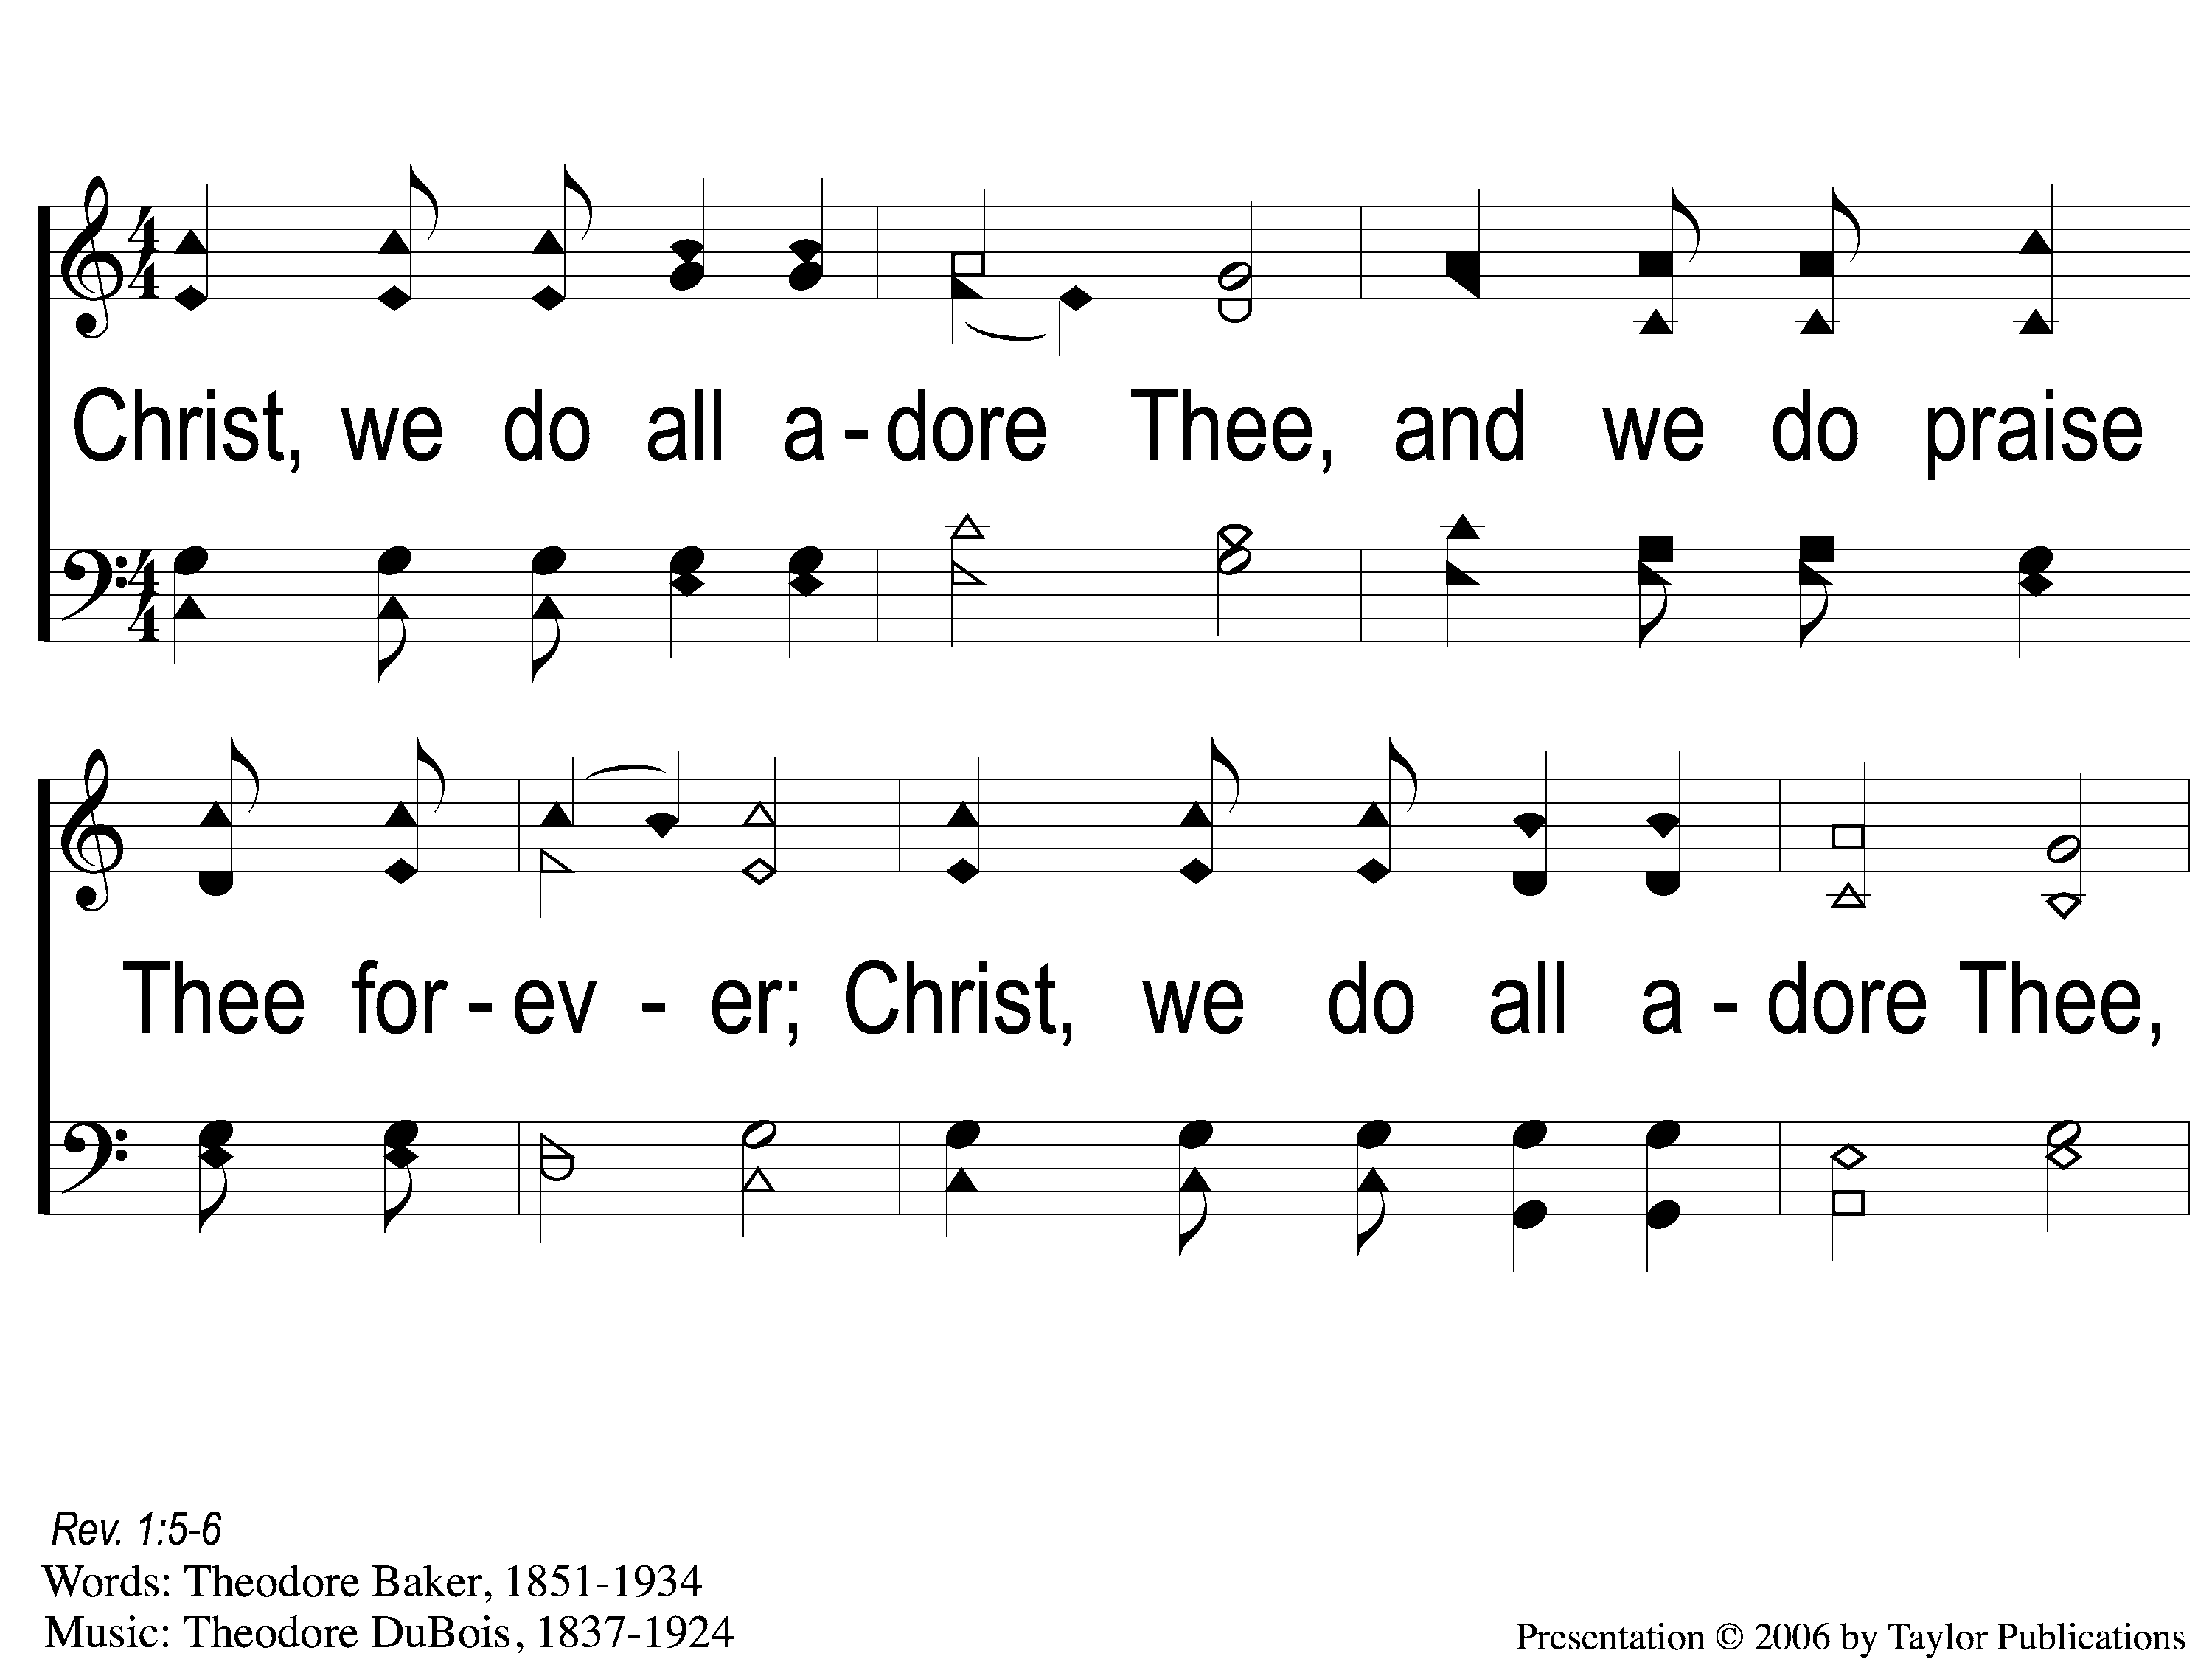
1 Christ We Do All Adore Thee
Christ We Do All Adore Thee
74

Slide 2
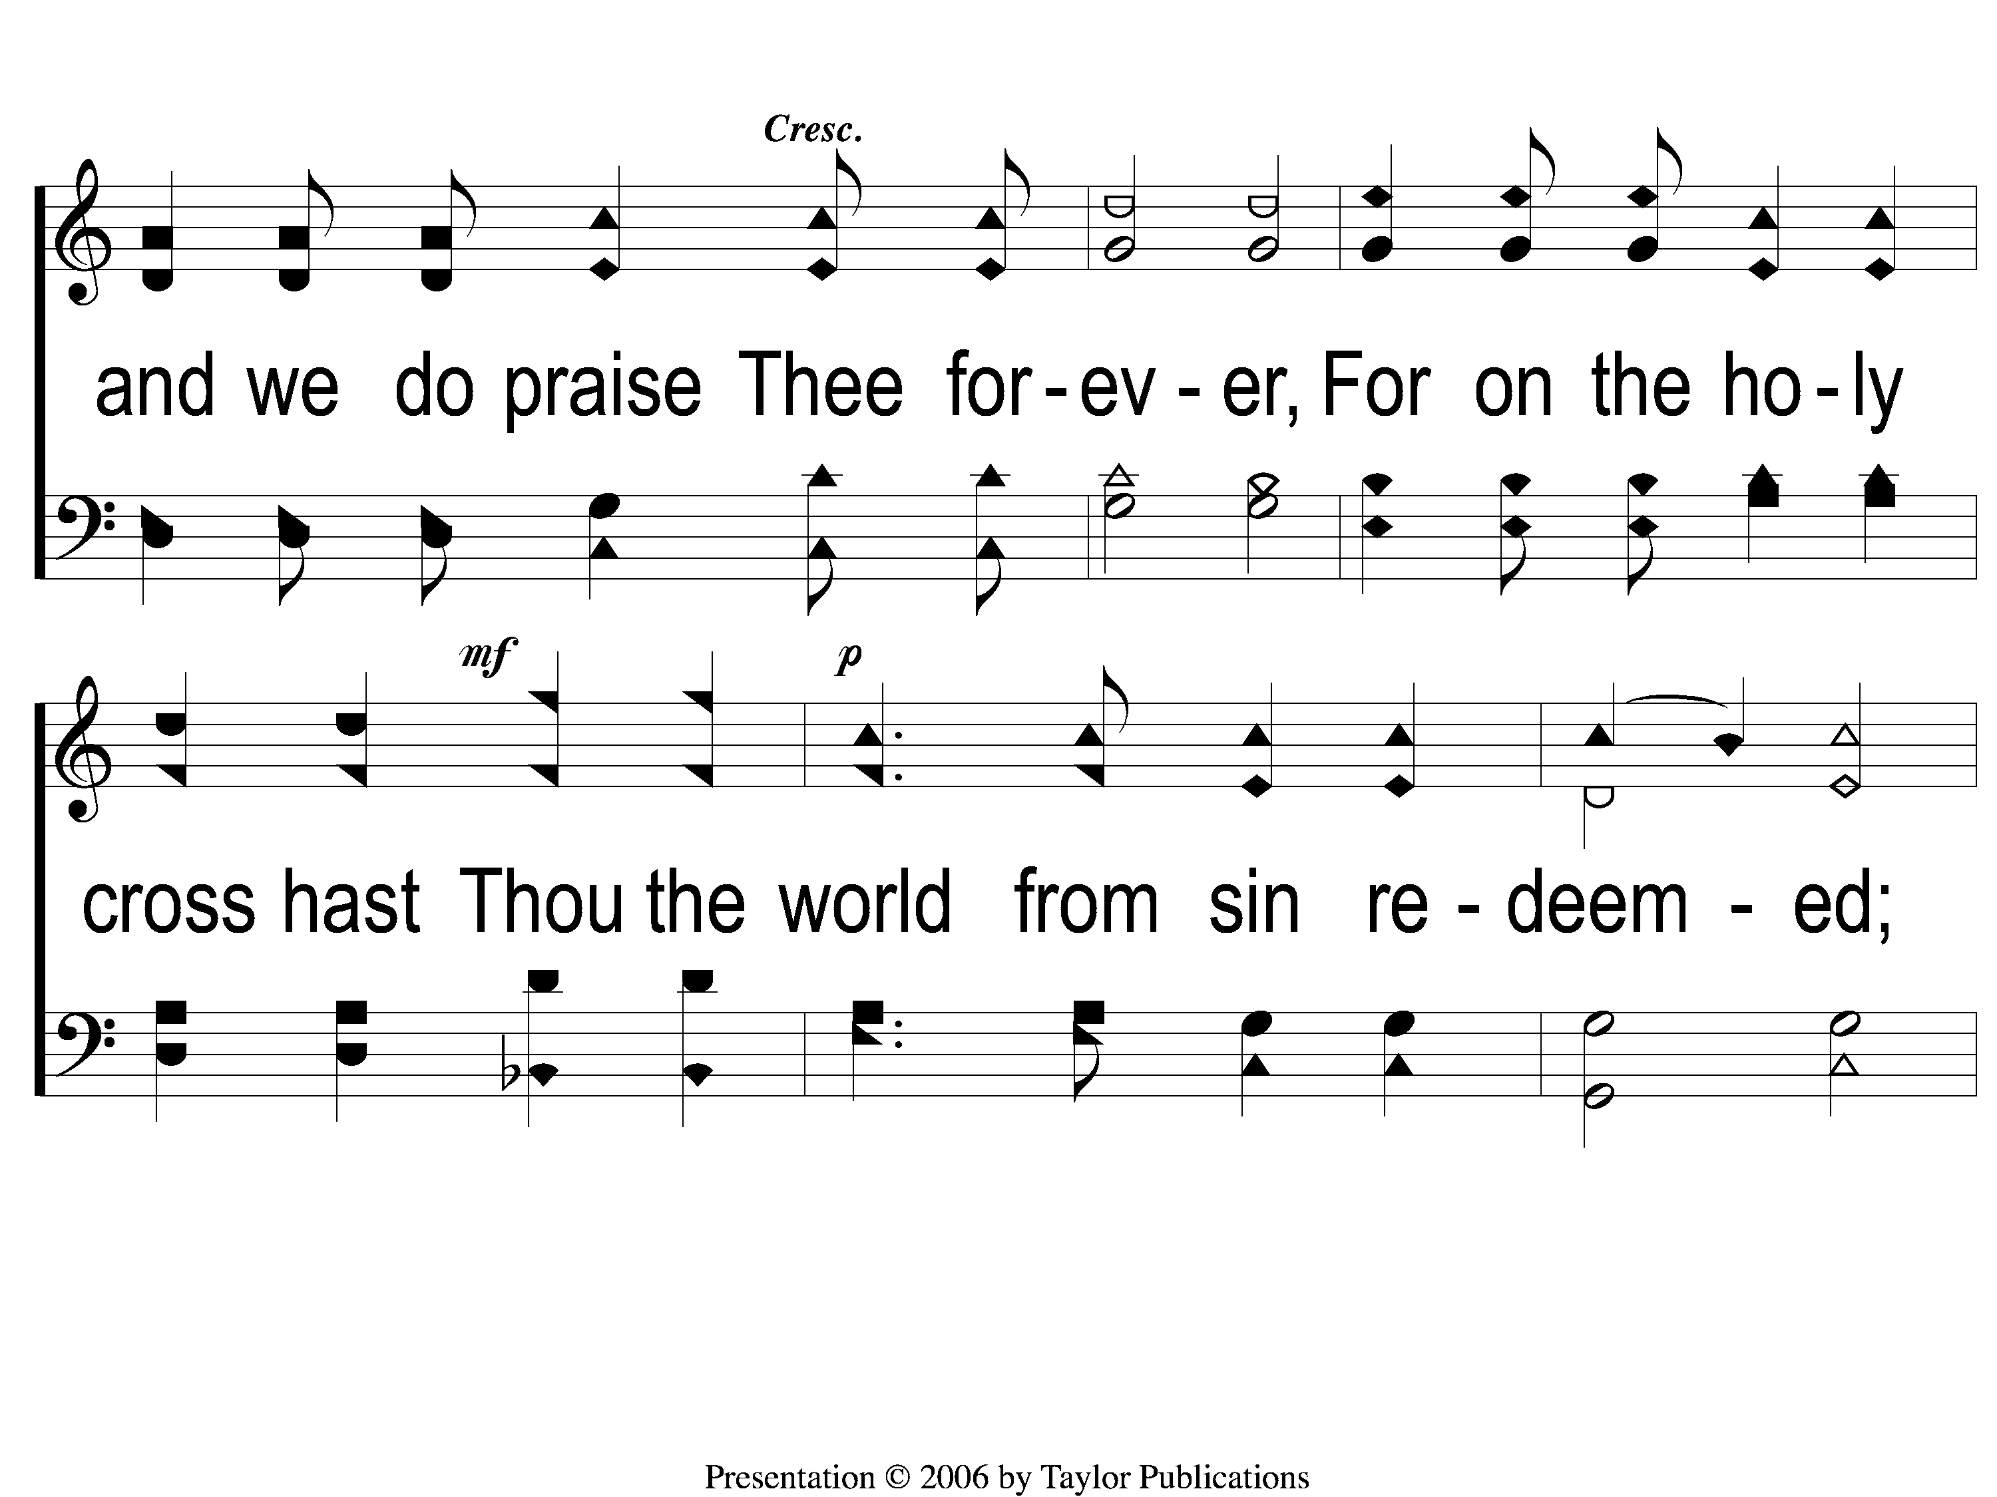
2 Christ We Do All Adore Thee
Christ We Do All Adore Thee
74

Slide 3
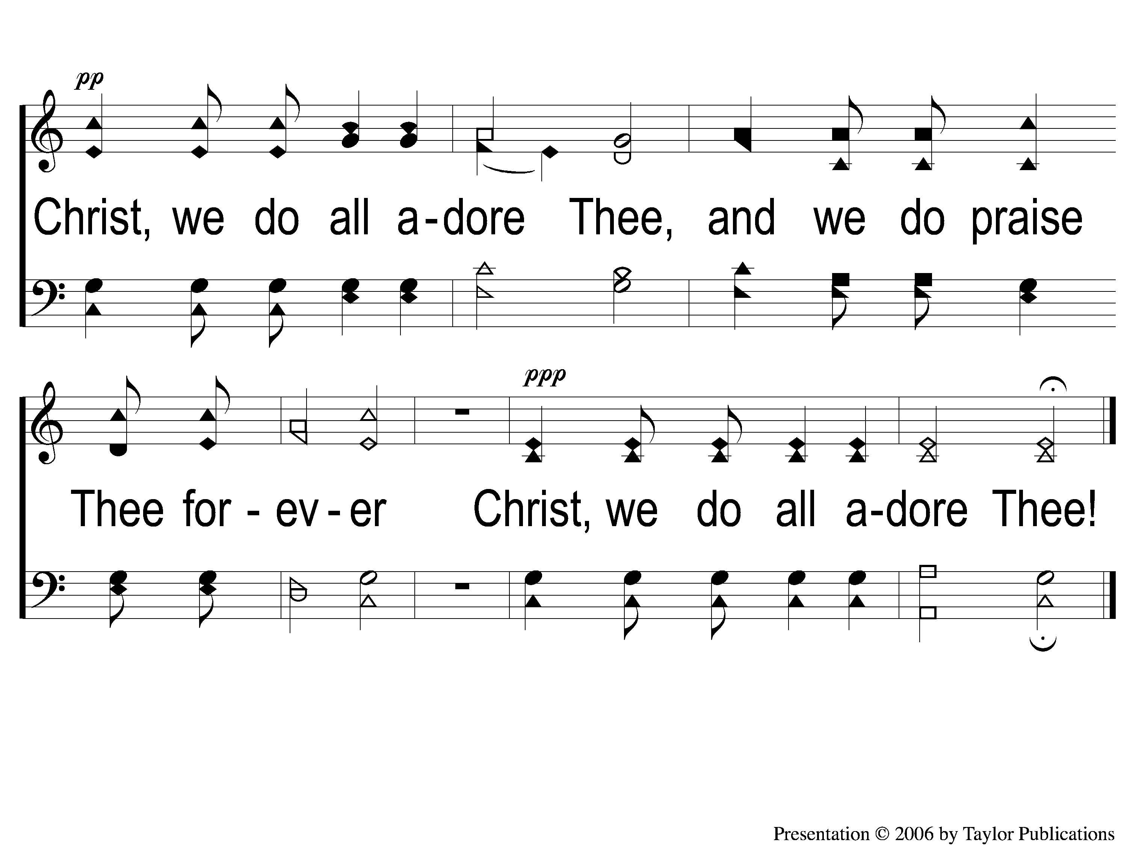
3 Christ We Do All Adore Thee
Christ We Do All Adore Thee
74

